Slide 1


SAP UI5 & FIORI with OData TRAINING
Anubhav Oberoy & Nishan Nainsukha
Day – 18

Slide 2

Agenda – Day 18
BAS Fiori App Integration with OData
Consuming Northwind OData Service
Fiori System Architecture
Fiori App Reference Library
Two types of SAP-Fiori App Implementation
ABAP deployment
Pre-requisites for Standard Fiori App
SAP Fiori Standard App Implementation
Relationship between Front-End Components
Trainer: Anubhav Oberoy & Nishan

Slide 3
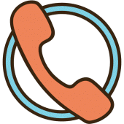
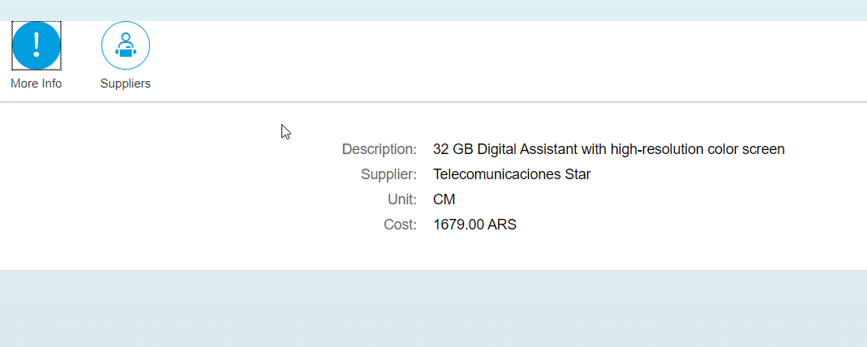
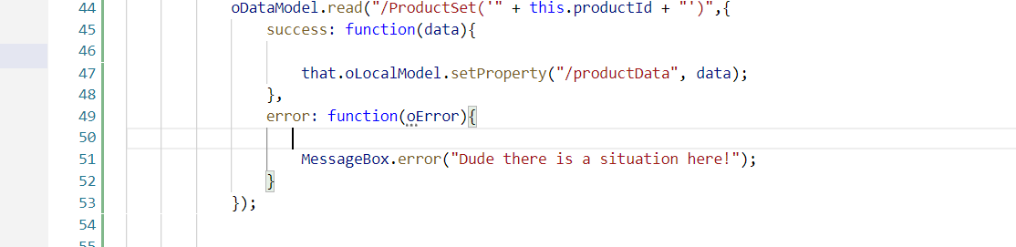
Getting Single Record
Step1: Changing the View2 controller Code.
Step 2: View2 code.
Step 3: Fragment code.(supplier , moreInfo)

Slide 4

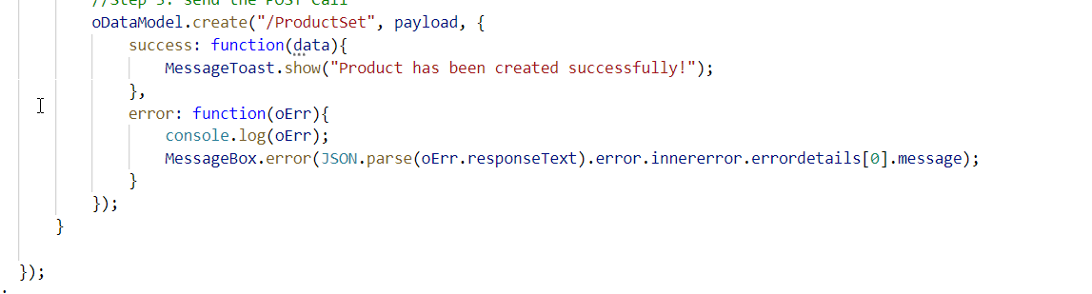
Performing Post From UI
Step1: Create Add Screen for User.
Step2: Create Add Controller .
Step3: Creating Footer on View1 Screen With Add Button.
Step4: Creating Entry for Add View in manifest.json .
Step5: Write add button logic in View1 Controller .

Slide 5
Function Import
Calling the Function Import From UI
var oDataModel = this.getView().getModel();
var that = this;
oDataModel.callFunction("/GetMostExpensiveProduct",{
urlParameters: {
"I_CATEGORY": 'Notebooks'
},
success: function(data){
},
error: function(oError){
}
});

Slide 6

End of Day 18

Slide 7

Questions

Slide 8

Anubhav Oberoy

Slide 9


We’re committed to empower you to be
Most Desirable Resource
through powerful training solutions.
We build the workforce of the future.
250+
Corporate Clients
30,000+
Learners Trained
25000+
Learners Placed
FREE WEBINARS
Sign up for free webinars with industry experts every fortnight!
Enroll Now!
Contact us today!
https://anubhavtrainings.com/

Slide 10




More from AnubhavTrainings.com

